Slide 1
Constructing a Reading Nook
Library improvement Project
By
Daylia Tangonan

Slide 2
Creating a Silent Reading Nook
Goal- Our goal is to transform an awkward and unused space into a wonderfully cozy reading nook to curl up in.
Purpose- We want to create an area away from everyone were students with a passion for books can sit quietly and read.

Slide 3
Plan
Approved by Mr. Hao & Ms. Mokuau
We Surveyed Students asking if we were to build a reading nook in the school library would they use the reading nook and how?.
Donation Letter- We ask Molokai local businesses to help us financially to construct our library improvement project witch is to create a reading nook.
If we didn’t get enough money from asking local businesses we were planning on fundraising doing plate sale but we were trying not fundraise because we felt that the money we will be dishing to fundraise we might not do good and we wouldn’t make the money back that we had put in to fundraise and construct our reading nook.

Slide 4
Budgeting
Materials; Wood, Fabric, Cushion, and Paint.
Budget estimated out to be 600$ but in actuality it only cost us 140$.
Mentor; Uncle Timmy Leong- Uncle Timmy had good ideas and I had shared those ideas and Sketches with my partner Rebecka Adolpho she had no input so I gave her sometime to think of what are we going to do?. With uncle Timmys idea he estimated building our reading nook would cost around 600$
Aunty Kalae Tangonan- I had gone to see aunty Kalae about painting our readying nook and then she came up with the idea of refurnishing to construct something old into something new like a reading nook so I brought the attention to my partner and teacher about it because of the time frame we had so little time left. Constructing something old into a new reading nook estimating cost would have been about 100$. My teacher had agreed that it sounded like a good idea but my partner still had no input but I felt my grade was important and I couldn’t wait on her anymore so I decided to go with aunty Kalae and to look at old furniture and we found this old vantage with dirty chairs and we ended up taking them home cleaning it and making it nice. I told Rebecka to meet me and this is what we are doing she never did and time was running out.
Pj- My aunty Kalae told me about Pj white that she makes cushion and I should give her a call and I did, pj was willing to make the cushion all she needed was to know the size of how big we wanted the cushion to be. Cushion cost 40$

Slide 5
Obstacles
Time Frame
Communication
Funding
Material list

Slide 6
success
I am just glad we finished our project because It looked and sounded like our project was going to be fun and fast to do but actually it wasn’t fun at all and it took longer then we expected it to be and it was very difficult and challenging I felt like giving up and not wanted to do this project anymore. I felt I did this project all by myself but in the end Rebecka pulled through stepped up and put together or project so that is our success.

Slide 7
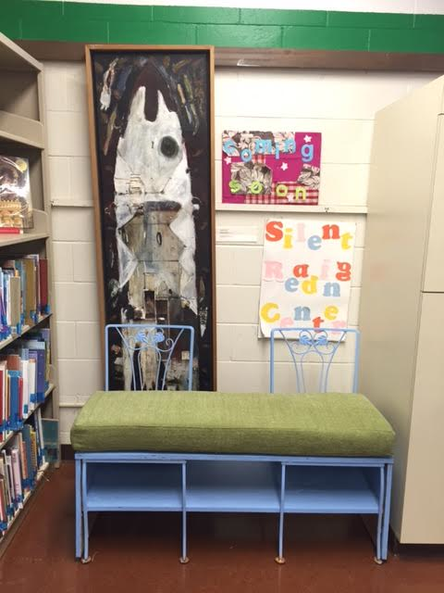
You can find magic wherever you look . Sit back and relax, all you need is a book.

Slide 8
Conclusion
In conclusion to this project, I had a hard time managing my time with Rebecka and meeting up to construct our project. I also had a hard time waiting on materials because I was in a rush because materials weren’t in when I needed it to be, but it came in a week ago and my partner Rebecka has pulled through to help me finish our project. I didn’t enjoy doing this reading nook but I know I had to do it to

